Slide 1

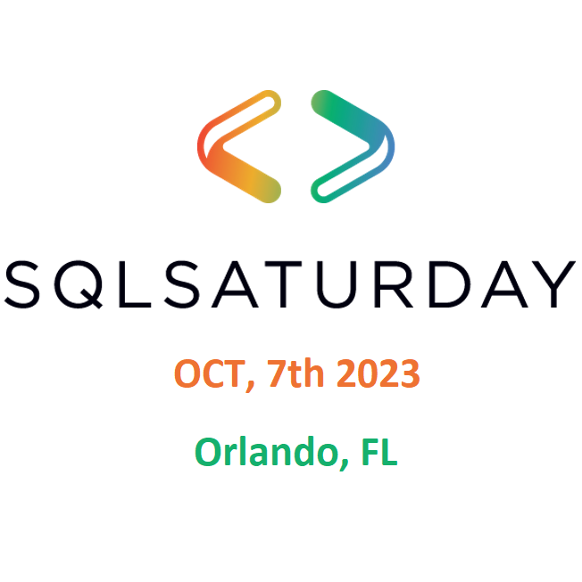


Slide 2


















Thank you, Sponsors!
Join Our Local User Groups:

Slide 3
There Are Nuances: Understanding SQL Server Backup and Recovery Options
Daniel Taylor
Notes:
https://learn.microsoft.com/en-us/azure/backup/backup-sql-server-vm-from-vm-pane
https://learn.microsoft.com/en-us/azure/backup/backup-azure-sql-database
https://learn.microsoft.com/en-us/sql/relational-databases/backup-restore/sql-server-backup-to-url?view=sql-server-ver16
https://learn.microsoft.com/en-us/sql/relational-databases/backup-restore/sql-server-managed-backup-to-microsoft-azure?view=sql-server-ver16
https://learn.microsoft.com/en-us/azure/azure-sql/accelerated-database-recovery?view=azuresql
https://learn.microsoft.com/en-us/azure/azure-sql/managed-instance/restore-sample-database-quickstart?view=azuresql
https://learn.microsoft.com/en-us/azure/azure-sql/managed-instance/log-replay-service-migrate?view=azuresql&tabs=sas-token
https://learn.microsoft.com/en-us/azure/azure-sql/database/long-term-retention-overview?view=azuresql
https://learn.microsoft.com/en-us/azure/azure-sql/database/automated-backups-overview?view=azuresql#backup-storage-redundancy

Slide 4

Daniel Taylor, Microsoft
Sr. Azure FastTrack CXP Engineer
Started as Sybase ASE / IQ DBA
SQL Server 2000 and beyond
Proud Geek, Video Gamer, and lover of the mountains
@dbabulldog
datay@microsoft.com
https://github.com/TalesFromTheField/Team-Presentation/tree/8c52fe558f6c30adbfdabd3002e83a64fe09c3ff/2023_SQL_Sat_Orlando/DanTaylor_BackupNuances
Notes:
https://github.com/TalesFromTheField/Team-Presentation/tree/8c52fe558f6c30adbfdabd3002e83a64fe09c3ff/2023_SQL_Sat_Orlando/DanTaylor_BackupNuances

Slide 5
Karthik Yella, Microsoft
@karthik_yv
vyella@microsoft.com
https://github.com/dbabulldog-repo/SharedPresentations.git
Sr. Azure FastTrack CXP Engineer
SQL Server 2000 and Beyond
Sports Fanatic

Slide 6


Slide 7

Our journey to understanding SQL Backup & Recovery
Solutions we will be examining
Backup & Recovery similarities
Backup & Recovery options & nuances
Things we can do to prepare
Notes:
Azure Backup support matrix for SQL Server Backup in Azure VMs - Azure Backup | Microsoft Learn
Automatic, geo-redundant backups - Azure SQL Database | Microsoft Learn

Slide 8
Solutions we will be examining

Slide 9
Solutions we will be examining
SQL Server on VM
PaaS Solutions
Azure SQL DB
Azure Managed Instance
Hyperscale

Slide 10
Backup & Recovery similarities

Slide 11
Backup & Recovery similarities
Backup Similarities
Full , Differential, and Log backups ( SQL DB, Manage Instance, SQL Server on VM)
Point in time backups
Backup compression
Recovery similarities
Point in time recovery
Accelerated database recoveries (Not for Hyperscale)
Default configuration for Azure SQL DB and Managed Instance
Available SQL Server 2019 forward
Notes:
Feature comparison of Azure SQL Database, Azure SQL Managed Instance and SQL Server on a VM - Microsoft Community Hub
https://techcommunity.microsoft.com/t5/fasttrack-for-azure/feature-comparison-of-azure-sql-database-azure-sql-managed/ba-p/3154789

Slide 12
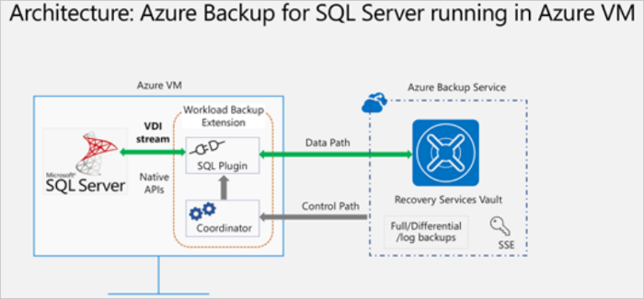
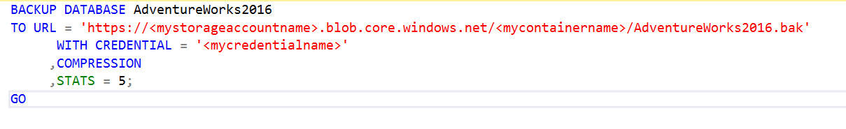
Backup and recovery SQL on VM
Backup
Backup to local drive
Backup to URL
Azure Backup service for SQL Server in Azure VMs
SQL Server managed backup to Microsoft Azure
Notes:
Managed Backup
https://learn.microsoft.com/en-us/sql/relational-databases/backup-restore/sql-server-managed-backup-to-microsoft-azure?view=sql-server-ver16
https://learn.microsoft.com/en-us/sql/relational-databases/backup-restore/enable-sql-server-managed-backup-to-microsoft-azure?view=sql-server-ver16&tabs=azure-cli
https://learn.microsoft.com/en-us/sql/relational-databases/backup-restore/configure-advanced-options-for-sql-server-managed-backup-to-microsoft-azure?view=sql-server-ver16

Slide 13
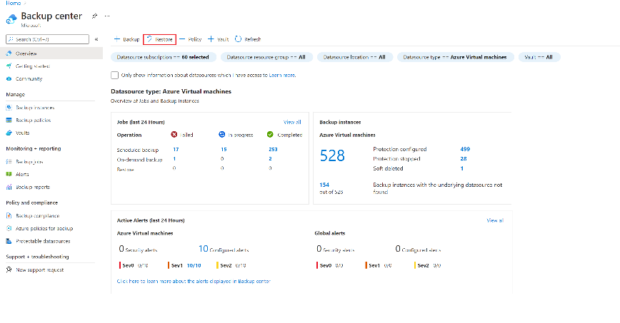
Backup and recovery SQL on VM
Recovery
Restore via the T-SQL
After Backing up to a local Drive or URL
From managed backup
After creating .bak from Azure Backup Service
Recover from the portal when using Azure Backup Service
Notes:
Managed Backup
https://learn.microsoft.com/en-us/sql/relational-databases/backup-restore/sql-server-managed-backup-to-microsoft-azure?view=sql-server-ver16

Slide 14
Demo: Backup to URL Demo: Enable Managed Backup
Notes:
Backup to URL
https://learn.microsoft.com/en-us/sql/relational-databases/backup-restore/sql-server-backup-to-url?view=sql-server-ver16
Managed Backup
https://learn.microsoft.com/en-us/sql/relational-databases/backup-restore/sql-server-managed-backup-to-microsoft-azure?view=sql-server-ver16
https://learn.microsoft.com/en-us/sql/relational-databases/backup-restore/enable-sql-server-managed-backup-to-microsoft-azure?view=sql-server-ver16&tabs=azure-cli
https://learn.microsoft.com/en-us/sql/relational-databases/backup-restore/configure-advanced-options-for-sql-server-managed-backup-to-microsoft-azure?view=sql-server-ver16

Slide 15
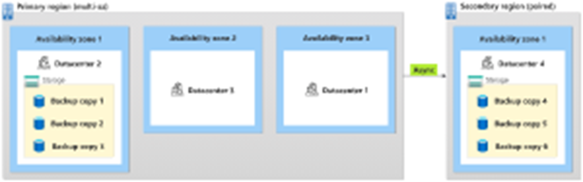
Backup & recovery Azure SQL DB / Managed Instance
Backup
Automated Backups
Weekly Full, Differential every 12 to 24 hours, Transaction Log backups every 10 minutes
Default is to store backups geo-redundant to paired region (LRS,ZRS,GZRS)
You can't change the schedule of backup jobs or disable them.

Slide 16
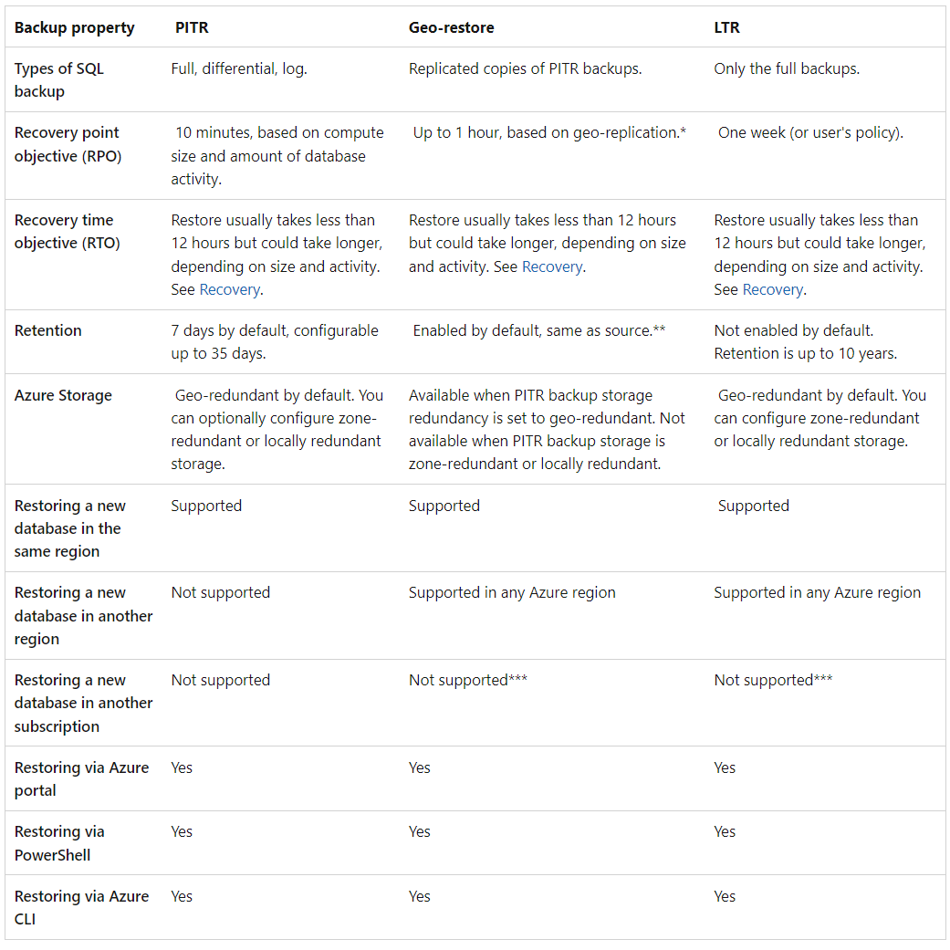
Backup & recovery Azure SQL DB / Managed Instance
Recovery
Restore an existing database to a point in time
Restore a deleted database to a point in time
Restore a database to another geographic region.
Restore a database from a specific long-term backup

Slide 17
Backup & Recovery options & nuances

Slide 18
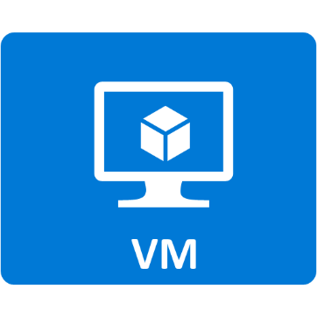
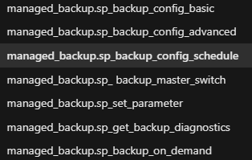
Backup and recovery SQL Server on VM (Nuance's)
SQL Server Managed Backups up to 30 days retention
SQL Server Managed Backups file backup is not supported
SQL Server Managed Backups and Backup to URL
Maximize size of block blob is 200 gig
12 TB Max for Managed Backup / 12.8 TB Max for URL
Notes:
Managed Backup
https://learn.microsoft.com/en-us/sql/relational-databases/backup-restore/sql-server-managed-backup-to-microsoft-azure?view=sql-server-ver16

Slide 19
Demo: Restore Managed Backup from URL
Notes:
Managed Backup
https://learn.microsoft.com/en-us/sql/relational-databases/backup-restore/sql-server-managed-backup-to-microsoft-azure?view=sql-server-ver16
https://learn.microsoft.com/en-us/sql/relational-databases/backup-restore/enable-sql-server-managed-backup-to-microsoft-azure?view=sql-server-ver16&tabs=azure-cli
https://learn.microsoft.com/en-us/sql/relational-databases/backup-restore/configure-advanced-options-for-sql-server-managed-backup-to-microsoft-azure?view=sql-server-ver16

Slide 20
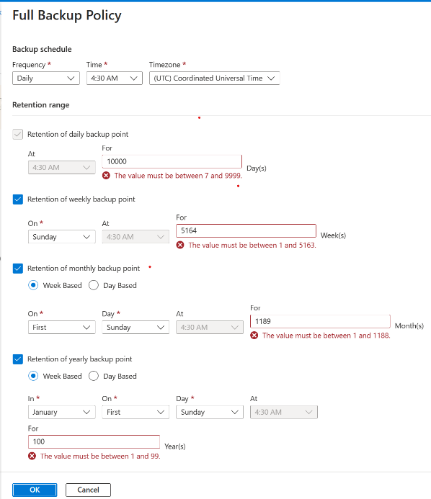

Backup and recovery SQL Server on VM (Nuance's)
Azure Backup for SQL Server
Max 2000 database per vault
Database max size support 6 TB
Max 1000 files per database
Disable log backups if using log shipping
Notes:
Support matrix for SQL Server Backup in Azure VMs
https://learn.microsoft.com/en-us/azure/backup/sql-support-matrix#scenario-support
F&Q
https://learn.microsoft.com/en-us/azure/backup/faq-backup-sql-server?source=recommendations

Slide 21
Demo: Examine Backup for SQL Server
Notes:
Support matrix for SQL Server Backup in Azure VMs
https://learn.microsoft.com/en-us/azure/backup/sql-support-matrix#scenario-support
F&Q
https://learn.microsoft.com/en-us/azure/backup/faq-backup-sql-server?source=recommendations
Azure Backup for SQL Server
https://learn.microsoft.com/en-us/azure/backup/backup-sql-server-database-azure-vms

Slide 22
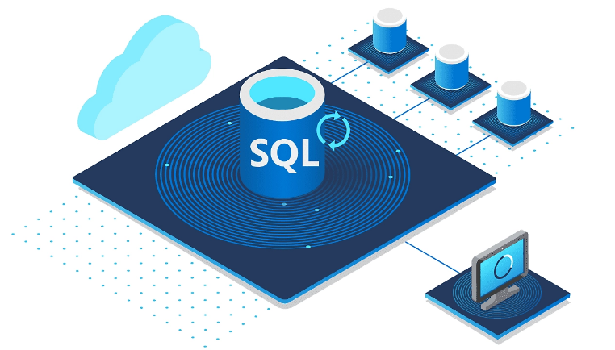
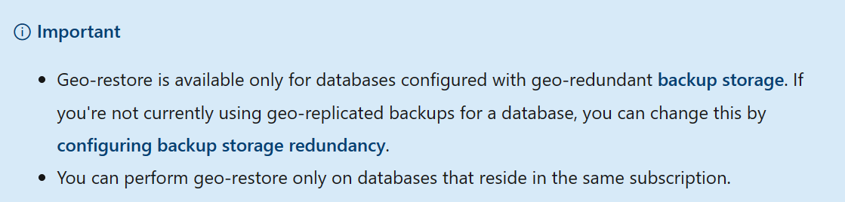
Backup and recovery nuances Azure SQL DB
Azure SQL DB
Database backup retention
Up to 35 days
Beyond that must use Long Term Retention
Can’t manually backup?
Can’t use native backup to recover
Can’t restore over existing DB (Replace)
We can use tools to extract Schema, Data or Both
Can examine backups via DMVs but no OOB alerting

Slide 23
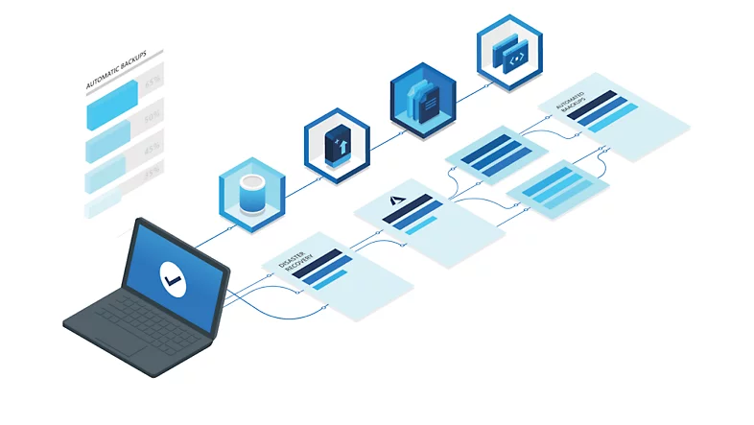
Backup and recovery nuances Azure MI
Azure Managed Instance
Database backup retention
Up to 35 days
Beyond that must use Long Term Retention
Can’t restore over existing DB (Replace)
Can manually backup database (copy only, TDE)
Can manually restore from backup (Full only)
Can examine backups via DMVs but no OOB alerting
Notes:
Restore Database
https://learn.microsoft.com/en-us/azure/azure-sql/managed-instance/restore-sample-database-quickstart?view=azuresql
Monitor backups
https://learn.microsoft.com/en-us/azure/azure-sql/managed-instance/backup-activity-monitor?view=azuresql

Slide 24
Demo: Backup to URL from Managed Instance Demo: Restore Managed Instance Database
Notes:
Backup and restore - https://bit.ly/3BtPAQS
RESTORE (Transact-SQL) - SQL Server | Microsoft Docs - https://bit.ly/3xzWyCM
Back up to URL best practices & troubleshooting for Microsoft Azure Blob Storage - SQL Server | Microsoft Docs - https://bit.ly/3BMprgD
Backing up a VLDB to Azure Blob Storage | Microsoft Docs - https://bit.ly/3qOL4Yp
https://learn.microsoft.com/en-us/azure/azure-sql/database/transparent-data-encryption-tde-overview?view=azuresql&tabs=azure-portal

Slide 25
Backup and recovery nuances Hyperscale
Azure SQL DB Hyperscale
Backups
Regular snapshots taken of the data files
Push down backups to storage layer
Default short-term 7 days ( Now GA up to 35 days)
Long-term backup retention (Now GA)
Restore to any point in times within retention policy
Reverting to applicable file snapshots
Applying transaction logs to make restored DB transactionally consistent
Notes:
Hyperscale backups
https://learn.microsoft.com/en-us/azure/azure-sql/database/hyperscale-automated-backups-overview?view=azuresql

Slide 26
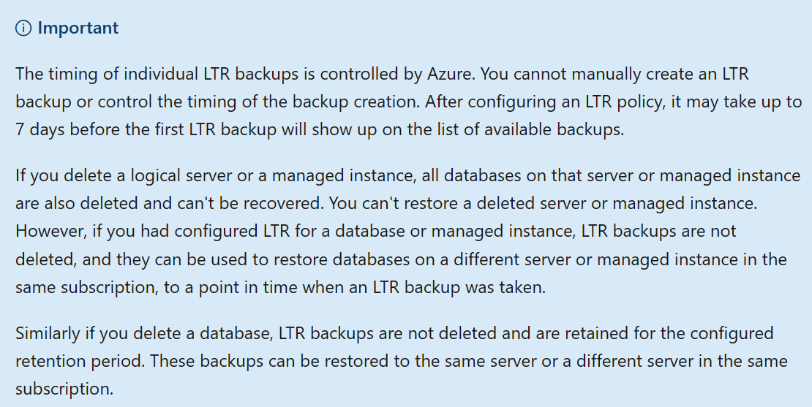
Backup and recovery nuances LTR
Let’s talk about Long Term Retention
Required if you want to keep backups more than 35 days
Requires Azure Blob Storage
Store for up to 10 years
Background job so no impact on Database performance
Four parameters:
weekly backup retention (W)
monthly backup retention (M)
yearly backup retention (Y), and week of year (WeekOfYear)
Scheduling COPY_ONLY backups an option (MI)
Notes:
If you specify W, one backup every week will be copied to the long-term storage.
If you specify M, the first backup of each month will be copied to the long-term storage.
If you specify Y, one backup during the week specified by WeekOfYear will be copied to the long-term storage.
If the specified WeekOfYear is in the past when the policy is configured, the first LTR backup will be created in the following year.
Each backup will be kept in the long-term storage according to the policy parameters that are configured when the LTR backup is created.
LTR
https://learn.microsoft.com/en-us/azure/azure-sql/database/long-term-retention-overview?view=azuresql

Slide 27
Things we can do to prepare

Slide 28
Things we can do to prepare
Dig deeper into the similarities and Nuances
Have recovery processes created and documented
Practice recovery of the databases
Validates documented process are correct
Validates that database backups are valid

Slide 29

Where did our journey take us?
Solutions we will be examining
Backup & Recovery similarities
Backup & Recovery options & nuances
Things we can do to prepare

Slide 31
Questions ?
Thank You!

Slide 32
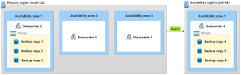
Backup and recovery Managed Instance
Backup
Automated Backups
Weekly Full, Differential every 12 to 24 hours, Transaction Log backups every 10 minutes
Default is to store backups geo-redundant to paired region (LRS,ZRS,GZRS)
You can't change the schedule of backup jobs or disable them.
Notes:
Automated Backups
Automatic, geo-redundant backups - Azure SQL Managed Instance | Microsoft Learn
https://learn.microsoft.com/en-us/azure/azure-sql/managed-instance/automated-backups-overview?view=azuresql#restore-a-database-from-backup
Backup Transparency
Backup transparency for backup history - Azure SQL Managed Instance | Microsoft Learn
https://learn.microsoft.com/en-us/azure/azure-sql/managed-instance/backup-transparency?view=azuresql

Slide 33
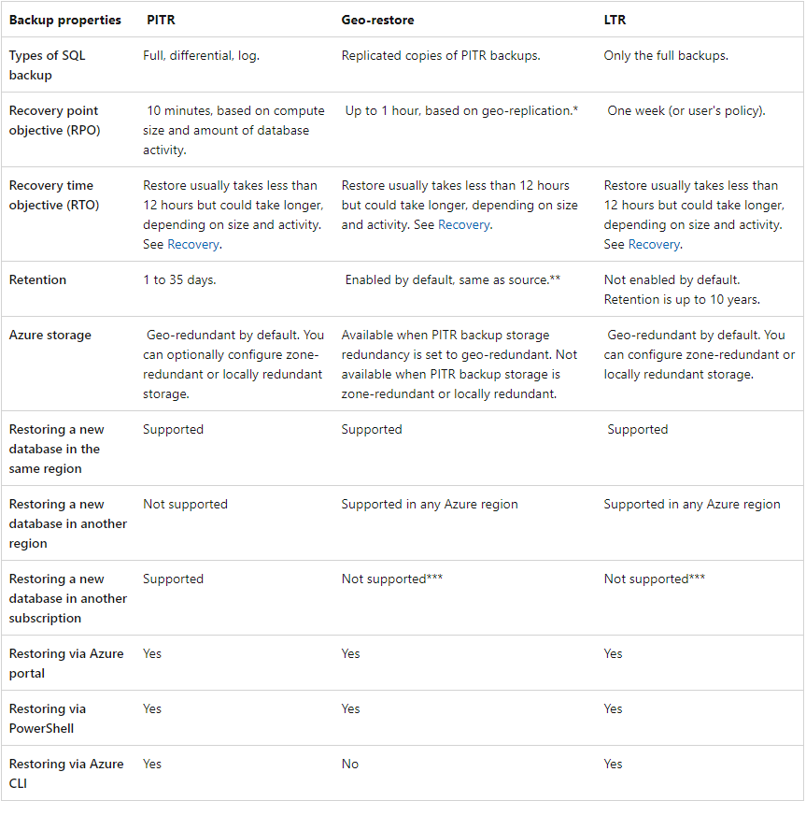
Backup and recovery Managed Instance
Recovery
Restore an existing database to a point in time
Restore a deleted database to a point in time
Restore a database to another geographic region
Restore a database from a specific long-term backup
Notes:
Automated Backups
Automatic, geo-redundant backups - Azure SQL Managed Instance | Microsoft Learn
https://learn.microsoft.com/en-us/azure/azure-sql/managed-instance/automated-backups-overview?view=azuresql#restore-a-database-from-backup
Backup Transparency
Backup transparency for backup history - Azure SQL Managed Instance | Microsoft Learn
https://learn.microsoft.com/en-us/azure/azure-sql/managed-instance/backup-transparency?view=azuresql

